Slide 1

Green Pace
Security Policy Presentation
Developer: Eric Kleihege

Slide 2

OVERVIEW: DEFENSE IN DEPTH
Automation will be used for the enforcement of and compliance to the standards defined in the following security policy. Green Pace has a well-established DevOps process and infrastructure, however, by merging these existing ideas with additional robust code, Green Pace will be equipped with a strong security framework that exercises strong defense in depth strategies. Many of the automations surrounding the standards in this policy will be designed to support defense in depth practices, ultimately adding multiple layers of security to Green Pace’s existing security infrastructure. This will span several areas, including assessing and planning, designing, building, maintenance, and monitoring through the utilization of various tools. Some tools that will assist with identifying potential security holes from the highlighted standards in this policy are LDRA tool suite, Polyspace Bug Finder, Astree, Parasoft C/C++ test, PC lint plus, CodeSonar, and Coverity.

Slide 3
THREATS MATRIX
This threat matrix shows the coding standards highlighted in the security policy and their relative level of likelihood versus severity. Further explanations of these potential security risks can be found on the slide labeled Coding Standards.
Likely MSC41-C | Priority STD-001-CPP STR02-C INT30-C ERR56-CPP
Low priority FIO42-C ERR06-C MEM03-C EXP63-CPP | Unlikely DCL60-CPP
Likelihood
Severity

Slide 4
10 PRINCIPLES
Principles
Principle | Explanation
1. Validate Input Data | Properly validating input from CLI, network interfaces, environment variables, and user-controlled files can reduce many software vulnerabilities that arise from lack of validation.¹
2. Heed Compiler Warnings | Compiler specific warnings are the highest warnings available for a specific compiler, and all warnings should be reduced by modifying code directly. This can be done through the use of static and dynamic tools created to eliminate security flaws.¹
3. Architect and Design for Security Policies | Design software that enforces security policies. An example would be to utilize privileges through channels of intercommunicating subsets, each with their specific privileges set accordingly.¹
4. Keep It Simple | It’s best to keep software designs simple, as complex designs increase the potential amount of errors that can be introduced into the software through implementation.¹
5. Default Deny | Configure base access around permissions. The configured security can identify conditions where access is granted.¹
6. Adhere to the Principle of Least Privilege | Each process should run with the minimal amount of privileges to do so. Elevated permissions should be granted for the smallest time window possible to allow a privileged operation to complete and nothing more.¹
7. Sanitize Data Sent to Other Systems | All data passed to complex systems (shells, databases, etc), should be sanitized to minimize risk of attackers gaining unauthorized access. SQL injection is an example that can be mitigated through data sanitization.¹
8. Practice Defense in Depth | Implement multiple defensive strategies that allow attacks to be further defended and potentially eliminated in the event they pass any initial barriers.¹
9. Use Effective Quality Assurance Techniques | Quality assurance can be impactful when identifying and eliminating vulnerabilities. Methods such as fuzz testing, pen testing, and source code audits should be incorporated as part of a QA program.¹
10. Adopt a Secure Coding Standard | Create or implement secure coding standards for target development languages and platforms. This ensures consistency in the code and reduces inadvertent security holes from being introduced into a system.¹
Mapping
4
3,7,9
1,8,9,10
7
3,9
3,10
1,3,4,5,6,8,9
1,3,7,8,9
1,3,8,9
1,3,6,8,9
Here we see which principle each coding standard maps to. Each standard becomes mapped to a principle based upon the nature of the risk involved with that specific standard and the explanation of the principle(s) involved.
Standards
# | Rule | Severity | Likelihood | Remediation Cost | Priority | Level
1 | STD-001-CPP | High | Unlikely | Medium | High | 2
2 | STR02-C | High | Likely | Medium | P18 | L1
3 | MEM03-C | Medium | Unlikely | High | P2 | L3
4 | ERR06-C | Medium | Unlikely | Medium | P4 | L3
5 | INT30-C | High | Likely | High | P9 | L2
6 | MSC41-C | High | Probable | Medium | P12 | L1
7 | FIO42-C | Medium | Unlikely | Medium | P4 | L3
8 | ERR56-CPP | High | Likely | High | P9 | L2
9 | DCL60-CPP | High | Unlikely | High | P3 | L3
10 | EXP63-CPP | Medium | Probable | Medium | P8 | L2
1. Top 10 secure coding practices. Top 10 Secure Coding Practices - CERT Secure Coding - Confluence. (n.d.). Retrieved January 20, 2023, from https://wiki.sei.cmu.edu/confluence/display/seccode/Top+10+Secure+Coding+Practices

Slide 5
CODING STANDARDS
This table presents the coding standards for the proposed security policy ranked by system vulnerability. These rankings were determined from the previous slide highlighting the relationship between the 10 principles and coding standards. The standards that aligned more closely with the principles received a lower ranking than those exhibiting fewer relationships. Thus, although some may suggest high severity or likelihood factors, the proper implementation of these standards allows their vulnerability factor to remain low when implemented in accordance with the principles.
Rule | Severity | Likelihood | Remediation Cost | Priority | Rank
STD-001-CPP | High | Unlikely | Medium | High | 1
STR02-C | High | Likely | Medium | P18 | 4
MEM03-C | Medium | Unlikely | High | P2 | 6
ERR06-C | Medium | Unlikely | Medium | P4 | 9
INT30-C | High | Likely | High | P9 | 8
MSC41-C | High | Probable | Medium | P12 | 7
FIO42-C | Medium | Unlikely | Medium | P4 | 10
ERR56-CPP | High | Likely | High | P9 | 2
DCL60-CPP | High | Unlikely | High | P3 | 5
EXP63-CPP | Medium | Probable | Medium | P8 | 3

Slide 6
ENCRYPTION POLICIES
This table summarizes encryption policies and how each is used to protect pertinent data based on encryption type.
Encryption Type | Encryption Definition
Encryption in rest | Encryption in rest refers to the notion of protecting data that is stored on disks, SSDs, and other forms of storage media.² This is especially important when information is stored for user accounts and passwords in a database along with any sort of authorization keys. Several areas of sensitive information that can be protected from encryption span across user logins, database changes, user files access, etc. The use of this encryption strategy is to ensure sensitive data remains secure and this implementation of encryption should be used to add enhanced security.
Encryption at flight | Encryption at flight is the practice of encrypting information that is being transferred.³ This is usually achieved through the use of AES keys where senders and receivers are aware of the keys used to transmit the information, thereby blocking anyone outside the intended recipient from gaining access to the information.³ This policy should be applied to protect data that is being sent to Green Pace servers from client machines, both internally and externally. Such data transfers encompass adding new users to a database, user logins, and user file access. The inclusion of encryption at flight is another helpful tool to include in any good security policy and security cycle.
Encryption in use | Encryption in use is a hybrid approach that blends some of the ideas from both in rest and at flight encryption tactics, but ensures that data is never unsecured no matter the stage or location of the information.⁴ Encryption in use is almost mandatory as this will allow any sensitive data to never remain unencrypted and only accessible for those intended.
2. Google. (n.d.). Default encryption at rest documentation, Google Cloud. Google. Retrieved February 12, 2023, from https://cloud.google.com/docs/security/encryption/default-encryption#:~:text=Encryption%20at%20rest%20is%20encryption,)%20algorithm%2C%20AES%2D256.
3. Content encryption: In Flight and at rest. IBM Aspera. (2020). Retrieved February 12, 2023, from https://www.ibm.com/docs/en/aspera-on-cloud?topic=encryption-content-in-flight-rest
4. Das, P. (2022, October 5). In-use encryption – what it is and how companies benefit. Sotero. Retrieved February 12, 2023, from https://www.soterosoft.com/blog/data-in-use-encryption-data-in-motion-encryption/#:~:text=In%2DUse%20encryption%20takes%20a,%2C%20cloud%2C%20or%20hybrid).

Slide 7
TRIPLE-A POLICIES
The table seen here provides definitions for Triple A (AAA) policies. Each policy number (principle) in this security proposal that support the specific “A” in Triple A can be seen in the far column labeled “Supporting Policy # ”.
Triple-A Type | Type Definition | Supporting Policy #
Authentication | Authentication is the aspect of AAA that aims to prevent anyone other than an intended user from gaining access to information about their demographics and ensures their credentials align with who the user states they are.⁵ This applies to user logins where users must be verified and checked against parameters such as their location or IP address when logging in. Any changes to a database should only be verified and published against authentication, along with authorization.⁵ | 1,7,8
Authorization | Authorization is tightly coupled with authentication, but differs in regards to privileges granted to specifics user groups and user roles.⁵ Authentication verifies who a user is, whereas authorization grants permissions to users once they’re authenticated. After a user logins to a system for example, they may have certain levels of access granted that allow them to add new users to a system, make modifications to a database, access certain files, or even allow/limit access permissions for other users.⁵ | 5,6
Accounting | Accounting is concerned with maintaining a log of what a user does or what occurs regarding their activity while logged into an organization network or company system.⁵ Accounting can be used to determine a user’s trends, activity, and even raise suspicions if any of these look abnormal. At the same time, should a malicious user gain access to a system in which they aren’t authorized, accounting will maintain a record of what the attacker performed, especially if they don’t/can’t clean up these logging records. | 3,8,10

Slide 8
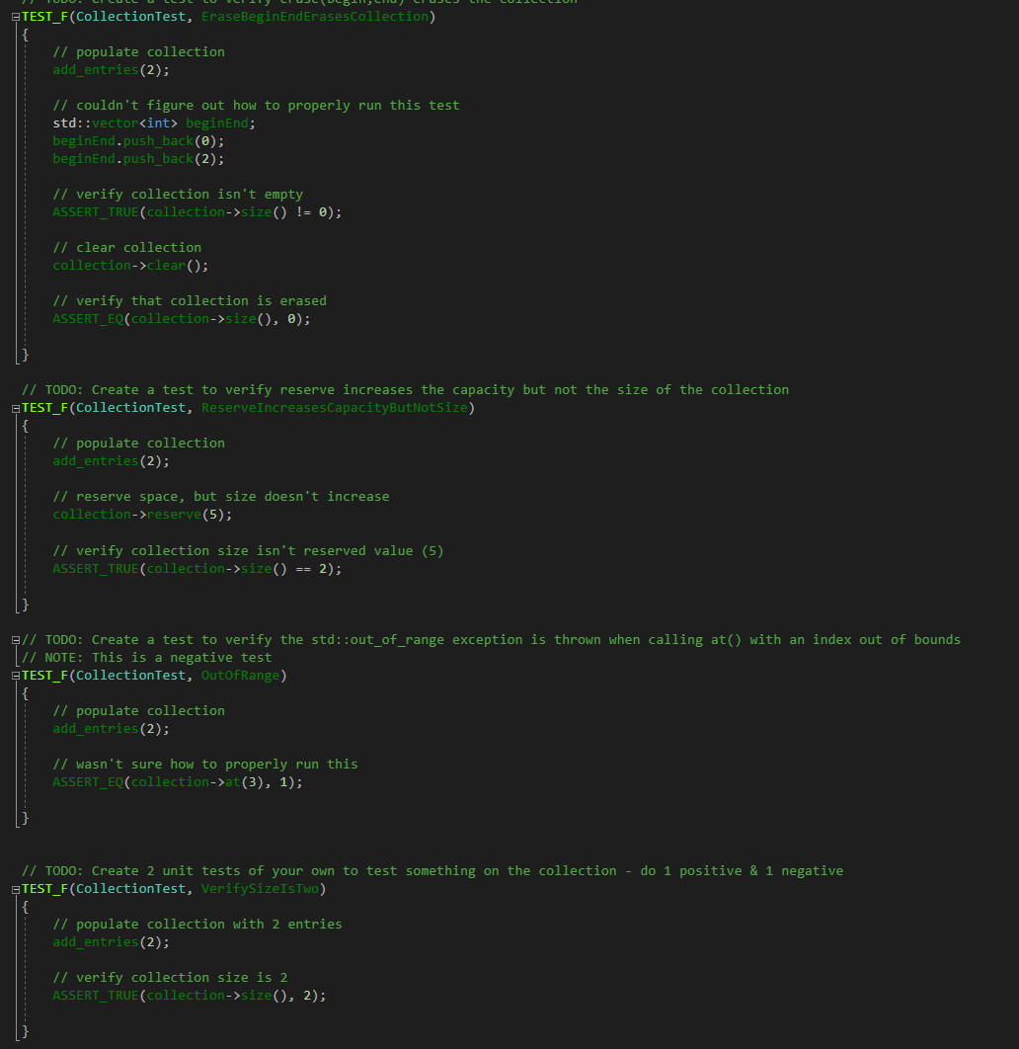
Unit Testing
The unit tests displayed here are examples that were run on code exhibiting similar properties to those that will be developed at Green Pace. Unit tests help to identify and validate code will run as intended. Although this code isn’t directly linked to Green Pace, the strategies and core ideas within remain the same. Code being developed for this project should adhere to unit testing based on the principles and standards outlined in this policy.

Slide 9

AUTOMATION SUMMARY & TOOLS
Automation will be used for the enforcement of and compliance to the standards defined in this presentation. Many of the automations surrounding the standards will reside in several areas, including assessing and planning, designing, building, maintenance, and monitoring. Some tools that will assist with identifying potential security holes from the highlighted standards are LDRA tool suite, Polyspace Bug Finder, Astree, Parasoft C/C++ test, PC lint plus, CodeSonar, and Coverity.
Through many of the stages in the DevSecOps cycle (see image), the aforementioned tools will be of paramount importance to ensure the best, secure free code is established and maintained at Green Pace. Assessing and planning will capitalize from principle 3 of architecting and designing for security policies. Although no code is written at this stage in the cycle, code structure and interconnectedness along with logic flow can be discussed and depicted to observe if any security flaws could potentially be introduced. Where the automation tools make great impact is throughout the designing and building phases and well into maintenance and monitoring/detection stages. The tools that have been identified to assist with this critical part of the DevSecOps lifecycle will exist to catch any potential vulnerabilities that make it into pre-production as well as production code. By ensuring the proper tools mentioned earlier are setup throughout the design and building phases, unit tests as well as code for building can be marked to add an extra mechanism of security revision prior to production. Once production is live, the maintenance and future code revisions will also have secure coding tools to automate the tasks of spotting potentially harmful code from being pushed. This cycle will then have these added security layers as part of production, which will allow code corrections to be spotted actively throughout the lifetime of Green Pace’s applications, overall enhancing their defense in depth goals.
*I combined these slides as I didn’t see a need to have a separate slide for tools

Slide 10
RISKS AND BENEFITS
The statement “don’t leave security to the end” rings true especially when working on a security infrastructure as important as Green Pace’s. This statement is intended to convey the importance of maintaining a security centric approach throughout the entire development process. This allows each line of code to be written with care and consideration to alleviate the chance of introducing logic that can lead to security holes. By ensuring each step throughout a project is taking software security into account, any final reviews and touchups can be almost minimal as much of the rigorous analysis and thought has already been accounted for. Any last-minute analyses and checks would ideally reveal tiny flaws that could be quickly addressed if the project was crafted with care and attention to security details.
By preventing threats and writing code to eliminate any from being introduced is a safer approach than recognizing that code may potentially leave a hole that can be addressed later will lead to more robust and less error prone code. The application has to be created regardless if anyone wants to observe software security practices or not, so why not ensure on the front end that no threats can be introduced?
The best steps to take would be to establish proper Defense in Depth (DID) controls to be prepared for when any unexpected threats target the system. Software security will always be a difficult field of expertise as it’s hard to foresee and predict every possible threat scenario that may target a system. The strategy to be as proactive as possible and minimize known holes from being introduced are key to ensure an all-around secure system that is prepared for the unfortunate times attacks do occur or threats are introduced.

Slide 11
RECOMMENDATIONS
Although gaps will always exist in security policies, Green Pace’s was evaluated and refactored in areas to enhance the overall security framework. Several gaps that still remain pertain to some of the testing tools that do not fully assess specific vulnerabilities that can arise. These consequently are only partially checked in some instances and could have stronger defense mechanisms to further reduce the chances of vulnerabilities being present.

Slide 12
CONCLUSIONS
Although a well-established security policy has been presented for Green Pace, it cannot possibly be exhaustive. Some additional standards that could be incorporated to prevent problems further down the line are:
STR32-C
STR34-C
FIO38-C
FIO46-C
MEM35-C
It is impossible to list an exhaustive report of options for additional standards to enhance security, but these are a good starting point.

Slide 13
REFERENCES
1. Top 10 secure coding practices. Top 10 Secure Coding Practices - CERT Secure Coding - Confluence. (n.d.). Retrieved January 20, 2023, from https://wiki.sei.cmu.edu/confluence/display/seccode/Top+10+Secure+Coding+Practices
2. Google. (n.d.). Default encryption at rest documentation, Google Cloud. Google. Retrieved February 12, 2023, from https://cloud.google.com/docs/security/encryption/default-encryption#:~:text=Encryption%20at%20rest%20is%20encryption,)%20algorithm%2C%20AES%2D256.
3. Content encryption: In Flight and at rest. IBM Aspera. (2020). Retrieved February 12, 2023, from https://www.ibm.com/docs/en/aspera-on-cloud?topic=encryption-content-in-flight-rest
4. Das, P. (2022, October 5). In-use encryption – what it is and how companies benefit. Sotero. Retrieved February 12, 2023, from https://www.soterosoft.com/blog/data-in-use-encryption-data-in-motion-encryption/#:~:text=In%2DUse%20encryption%20takes%20a,%2C%20cloud%2C%20or%20hybrid).

